Slide 1
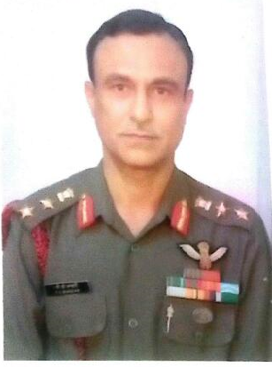
Col Pawan Chander Bhandari,SC (Retd)
Army Avn Corps
School No. 325
House: Kurukshetra
Batch: 1963-69
On 06th Sep 1983 Capt (now Col) (Retd) Pawan Chander Bhandari rescued an Austrian lady mountaineer who was trapped at Kun Peak (23100 ft). In this daring casualty evacuation mission, he himself got deplaned from helicopter, negotiated a crevasse, physically lifted the casualty and shifted her into waiting helicopter. In utter disregard to his personal safety, he displayed great courage and dedication of a very high order and was awarded with ‘SHAURYA CHAKRA’ by Hon’ble President.

Slide 2
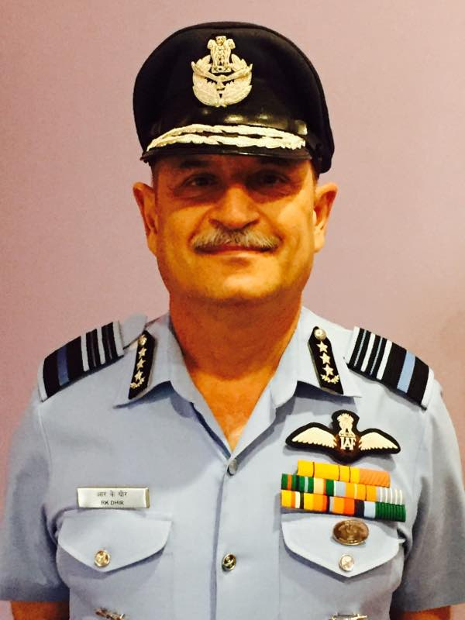
Air Marshal R K Dhir,AVSM,VM,ADC
School No. 845
House: Panipat
Batch:
The Air Marshal was commisioned in IAF as fighter Pilot on 15 June 1979. In his 37 yrs of service he has flown extensively on various types of fighter aircrafts. He has held various important instructional, staff and command appointments. For distinguished service of most exceptional order he was awarded with “VAYU SENA MEDAL” in Jan 2006, “ATI VISHIST SEVA MEDAL” in Jan 2012. Presently he is serving as AOC-IN-C, South Western Air Command and has been awarded with “PARAM VISHIST SEVA MEDAL” on 6th Apr 2017 by Hon’ble President.

Slide 3
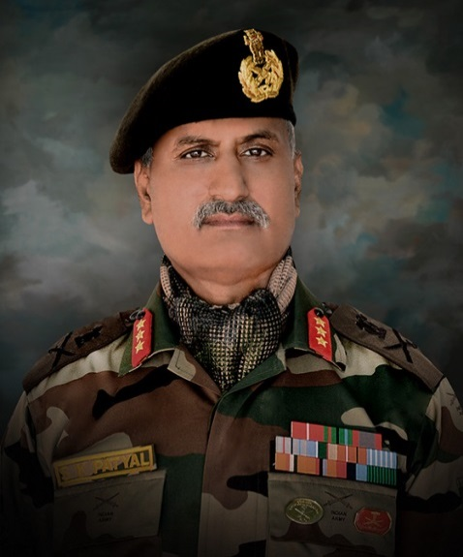
Lt Gen S K Patyal, UYSM, SM, PhD
School No. 850
House:
Batch:
The General was commissioned into Army on . In his long illustrious service, he has held various important instructional, staff and command appointments. Presently, he is serving as DCOAS (P&S) in IHQ MOD (Army). For his distinguished service of most exceptional order he was awarded with “UTTAM YUDH SEVA MEDAL” in Jan 2017 by Hon’ble President.

Slide 4
Maj Gen JS Nain, AVSM, SM
School No. 1258
House: Panipat
Batch: 1972-79
A former School Captain and Best All Rounder, The General was commisioned into Army in 2 DOGRA in 1983. He was first in order of merit in his course. In his long illustrious service, he has held various important instructional, staff and command appointments. Presently, he is serving as Additional MS (B) in MS branch of IHQ MOD (Army). He has been awarded with COAS commendation Card thirce and Army Cdr Commendation Card once.
For his distinguished service of most exceptional order he was awarded with “SENA MEDAL” in 2016 and “ATI VISHISTH SEVA MEDAL” on 06 Apr 2017 by Hon’ble President .

Slide 5
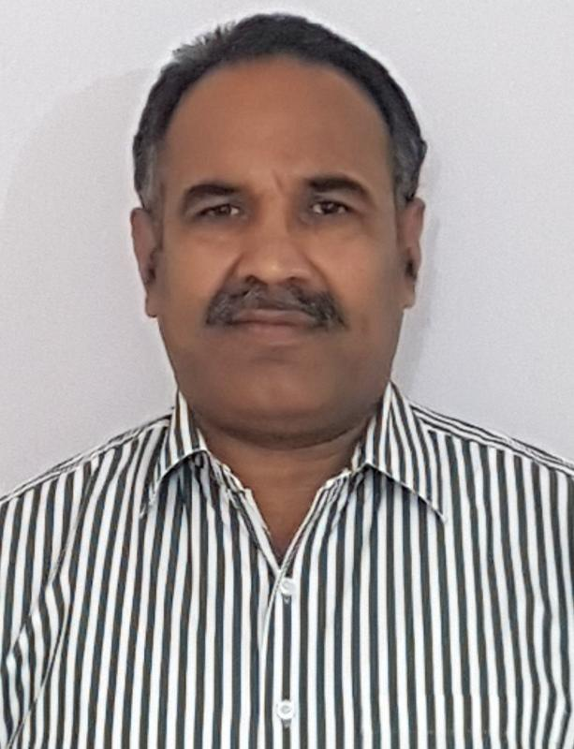
Mr Rajender kumar
School No. 1506
House: Kurukshetra
Batch: 1974-82
Mr Rajender kumar cleared the prestigious HPSC exam in 1990 and got selected in HPS as Dy SP of Gurugram city. He was promoted to IPS cadre by UPSC in 2002 and was promoted as Supt of Police of Faridabad. In year 2014, he was promoted to the rank of Dy Insp General of State Vigilance Dept and subsequently as Insp General of Police 2016. Presently he is serving as IGP CM Flying squad in Haryana Police HQ at Panchkula.
For his distinguised service of most exceptional order, Mr. Rajender Kumar was awarded with coveted Police Medal for Meritorious Service on Republic Day 2017.

Slide 6
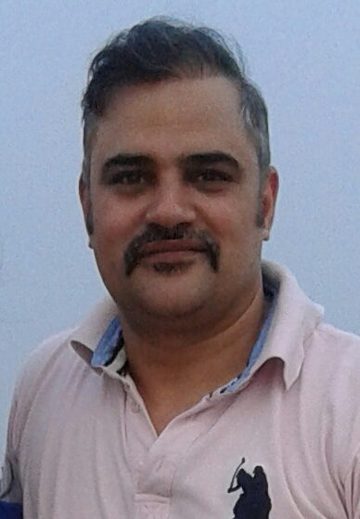
Dr Surender Bishnoi
School No. 2446
House: Chillianwala
Batch: 1983-90
Dr Surender Bishnoi who is an ENT Surgeon, is posted at Civil Hospital, Rohtak. He alongwith Mrs Surender Bishnoi was awarded by State Home Minister with the “Distinguished Service Award” for their selfless and dedicated service to the humanity.
He is a keen veteran sportsman and he stood first in national veteran atheletics championship held in Chattisgarh in Nov 2016.

Slide 7
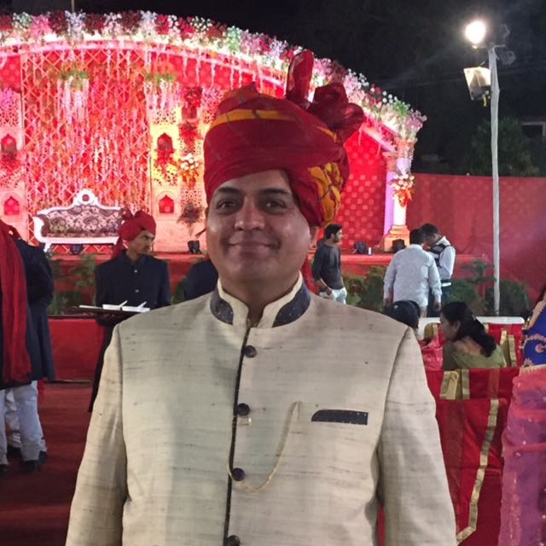
Mr Sandeep Kaushik
Architect
School No. 1895
House: Chillianwala
Batch: 1977-85
Mr Sandeep Kaushik is a well known architect. He has a private firm “VISTARA CONSULTANTS”, based in Panipat city. He was awarded ‘Certificate of Excellence’ by the Indian Concrete Institute for his outstanding work in the field of construction.

Slide 8
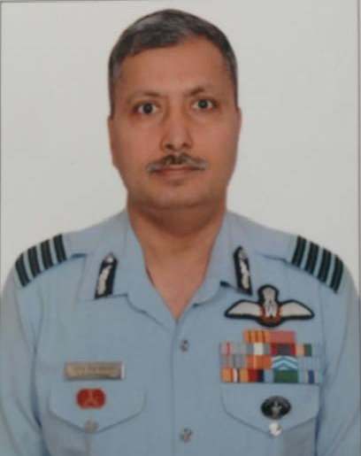
Wg Cdr B S Sehrawat, YSM, VM
School No. 2576
House: Kurukshetra
Batch: 1985-92
He joined IAF as pilot in flying branch on 21 Dec 1996. He commanded a Cheetah/Cheetal Sqn in Siachen Glacier. He executed more than 4000 landings in ‘Operation MEGHDOOT’ at world’s highest helipads. He has displayed an exceptional courage, professionalism, leadership and distinguished service order in hostile situations .
He was awarded with “YUDH SEVA MEDAL” in 2016. He is also the recipient of Vayu Sena Medal in 2007.

Slide 9
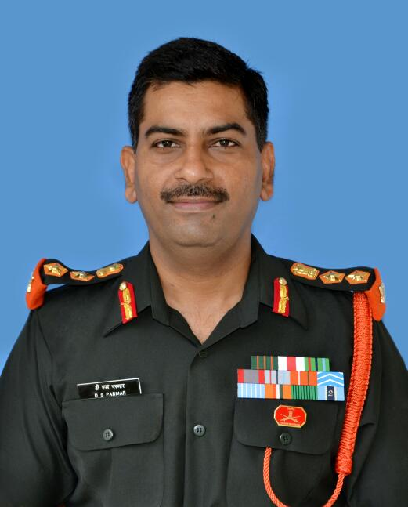
Col Dinesh Singh Parmar, SC
2 SIKH LI
School No. 2692
House: Kurukshetra
Batch: 1985-92
On 18th Oct 2008 at 0955 hrs Maj (now Col) Dinesh Singh Parmar was leading a search party in a village in Rajouri (J&K) when his search party drew heavy fire from a terrorist hideout. He brought down effective fire into hideout eliminating one terrorist. Despite suffering grievous abdominal injury, eliminated another terrorist before being evacuated due to excessive bleeding. He displayed cool courage, nerves of steel, dogged determination and acted beyond the call of duty.
For this gallant action he was awarded “SHAURYA CHAKRA”.

Slide 10
Mr Hoshiyar Baliyan, President Police Medal(G)
16 Bn (ITBP)
School No. 2599
House: Kurukshetra
Batch: 1984-91
On 17th Jun 2002 at 0400 hrs Shri Hoshiyar Singh Baliyan ,Assistant Comdt along with his team on receiving the specific info of HM terrorists presence in a hideout at Bisran village of Doda Distt, J&K. In a fierce encounter he neutralized two terrorists and recovery of heavy war like stores was made.
In displaying conspicuous gallantary, courage and devotion to duty of high order for this act of bravery, he was awarded “President Police Medal (Gallantary)” by Hon’ble President .

Slide 11
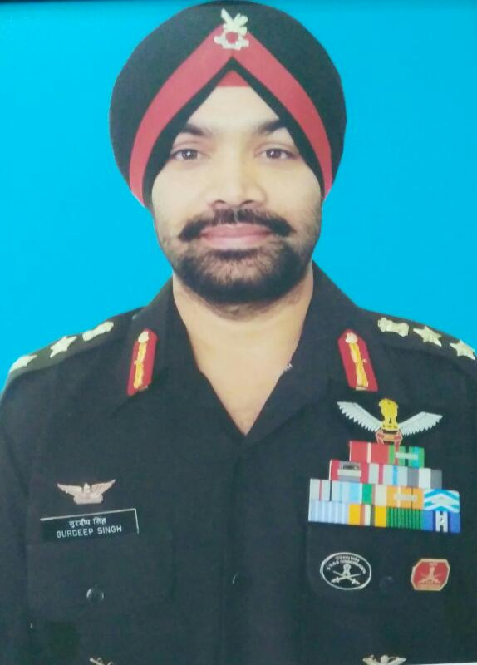
Col Gurdeep Singh, SM
Army Avn
School No. 2797
House: Chillianwala
Batch: 1986-93
Lt Col (now Col) Gurdeep Singh executed a daring casualty evacuation mission from own winter cutoff post on Line of Control at a height of 18600 ft barely 500m away from Pakistani posts. With total disregard to his personal safety, in exceptionally hazardous weather picked up the casualty in low hover, thereby saving the precious life of a comrade. For this gallant act, he was awarded Mention-in-Dispatches in Jan 2013.
He has been awarded with one COAS commendation Card and four Army Cdr Commendation Cards in his career. For his outstanding contribution in Kargil- Dras Sector and saving numerous lives in challenging high altitude posts, he was awarded “SENA MEDAL” in Jan 2014.

Slide 12
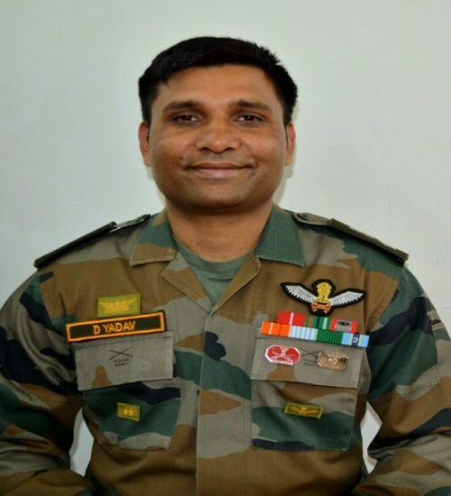
Lt Col Dhirender Yadav, SM
Army Avn
School No. 3294
House: Panipat
Batch: 1990-97
On 25th July 2012, Maj (now Lt Col) Dhirender Yadav carried out an emergency casualty evacuation of serving soldier who had sustained gunshot wound on being fired upon by M23 rebels at Kiwanja COB. The aviator extricated wounded soldier by unarmed Cheetah hepter amidst the effective rebels fire which resulted in saving the life of an indian soldier thereby bolstering the morale of the troops by upholding the UN mandate.
For this gallant act he was awarded “SENA MEDAL” (Gallantary). He has also been awarded with Mention-in Despathces in 2003.

Slide 13
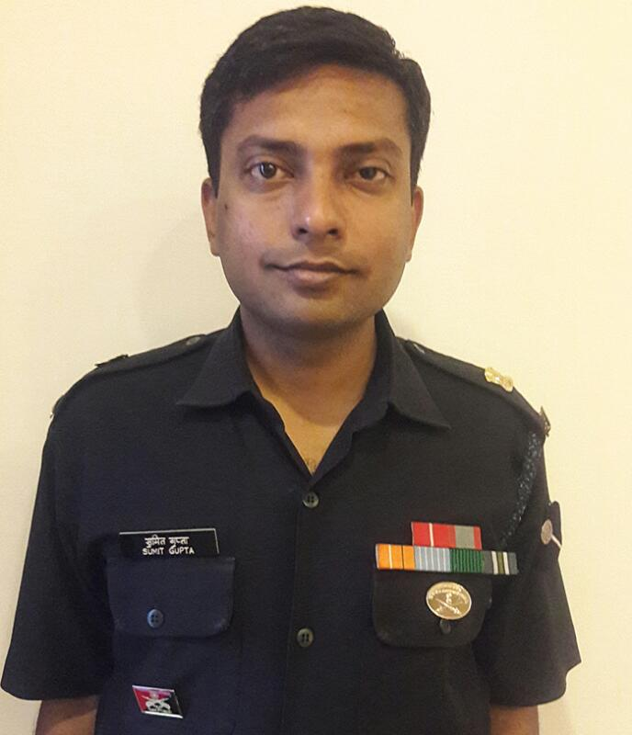
Maj Sumit Gupta, SM
School No. 3713
House: Thaneshwar
Batch: 1993-2000
On night 12th Apr 2009 Capt (now Maj) Sumit Gupta while leading a search party in village Wakhanpur, Bandipura Distt (J&K) sensed the presence of few militants hiding in a forested area close to a group of houses. Demonstrating grit and courage the officer crawled stealthily towards the hideout in the ensuing gunfight, wherein he eliminated two hardcore LeT terrorists in the “OPERATION WAKHANPURA”.
For this exceptional act of bravery the officer was awarded “SENA MEDAL” (Gallantary).

Slide 14
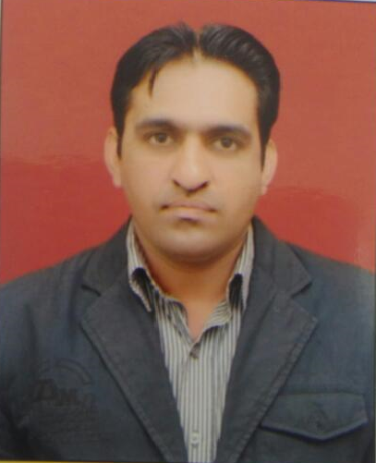
Mr Ashok Chahar
International Management Consultant
School No. 4144
House: Kurukshetra
Batch: 1996-03
Mr Ashok Chahar is an IITian and and an alumnus of IIM Kolkata. He is a leading international management consultant and is closely associated with CII and Make in India initiative.
While working with HPCL he was the junior most officer who was awarded with “Outstanding Achievement Award” for his significant contribution in developing petroleum products storage facilities in the remotest locations in J&K for the Indian Armed Forces.
He was also appreciated by the Parliamentary Committee (GOI) for his contribution in implementing Hindi language programme in HPCL in J&K region.

Slide 15
Maj Munesh Gujjar, SC
School No. 4369
House: Panipat
Batch: 1997-2004
On 11th May 2016 Maj Munesh, based on specific info planned and executed “OPERATION RIPU” resulted in destruction of a terrorist camp and neutralised one of Top commander of ‘National Democratic Front of Bodoland (S)’ who was responsible for massacre of innocent Adivasis on 23 Dec 2014 in Kokrajhar Distt of Assam.
For this indl act of exceptional bravery, highest regard for human life and safety, beyond the call of duty he was awarded “SHAURYA CHAKRA.

Slide 16
Maj Dalbir Malik, SM
7 JAT
School No. 4343
House: Chillianwala
Batch: 1998-2005
On 21st Jul 2014 Maj Dalbir Malik planned and executed “OPERATION PHULJHORA” which resulted in elimination of one terrorist in Kokrajhar Distt of Assam. Despite being grievously injured, he neutralized the terrorist under the fierce gun battle displaying raw courage and exceptional bravery.
For this exemplary leadership and conspicuous gallantry, beyond the call of duty he was awarded “SENA MEDAL” (GALLANTARY).

Slide 17
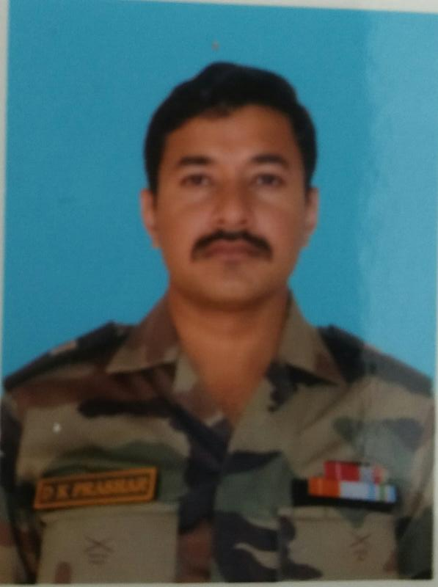
MAJ DEEPAK PARASHAR, SC
INT
School No. 4452
House: Chillianwala
Batch: 1998-2005
On 25thDec 2009 Lt (now Maj) Deepak Parashar as Ghatak Platoon Cdr after got a specific int regarding movement of NDFB militants in Paharpur, distt Sonitpur, Assam. The offr along with his buddy crawled under heavy terrorist fire and neutralized two dreaded NDFB militants which in turn reduced the militant outfit’s activities in the area. For his selfless and daring action and gallantry act, he was awarded “SHAURYA CHAKRA” by Hon’ble President.

Slide 18
Maj Ashish Chhikara, SM
5 RAJPUT
School No. 5194
House: Kurukshetra
Batch: 2001-2008
On night 11/12 july 2015, Capt(Now Maj) Ashish was deployed at Line of Control as post commander while displaying sound tactical acumen he detected movement of three terrorist on LC fence through BFSR. Displaying raw courage and utter disregard to personal safety he crawled towards the terrorist’s location in poor visibility and eliminated one terrorist in Keran sector of J&K. For this exemplary leadership and conspicuous gallantry, beyond the call of duty he was awarded “SENA MEDAL” (GALLANTARY).

Slide 19
Wg Cdr Deepak Kumar Vats, VM
School No.
House:
Batch:
On 26th Nov 2008 Mumbai was shaken by the worst terror attack, the country had ever witnessed, the situation was not less than an all out Urban War. On 28th Nov 2008 , he was detailed as co-pilot of MI-17 helicopter and was tasked to slither down a team of NSG commandos on the terrace of Nariman House. He displayed exemplary courage and leadership while flying into the line of fire as co-pilot. For this act of exceptional courage he was awarded “VAYU SENA MEDAL”.

Slide 20
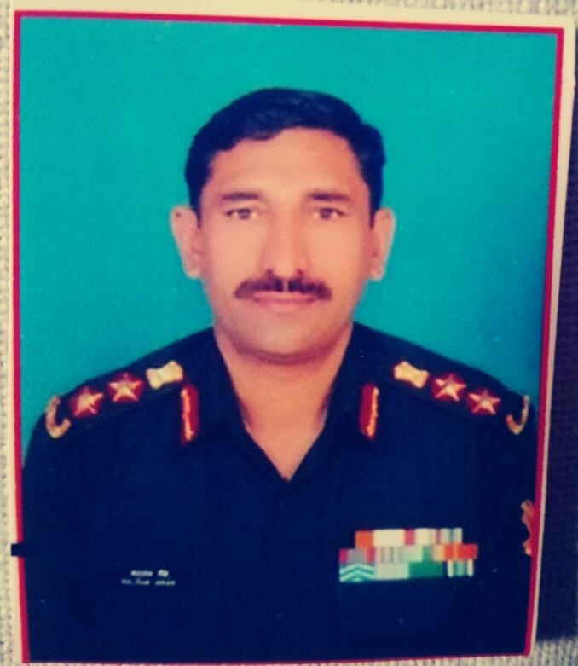
Col Balwan Singh, MVC
18 GREN
School No. 2642
House: Thaneshwar
Batch: 1985-92
On 3rd July 1999, the offr with three months of service led a multi pronged attack from North East direction on Tiger Hill, a national objective. The team under his command moved over 12 hours under intense Arty shelling to reach the designated spur, this move took enemy totally by surprise as his team used using cliff assault mountaineering equipment to reach the top with stealth. On seeing his team enemy opened intense automatic fire causing serious injury to the offr . He refused to be evacuated and engaged the enemy killing four of them in close combat personally. For his inspirational leadership, ferocity and unparlleled courage, he was awarded “MAHAVIR CHAKRA”.

Slide 21
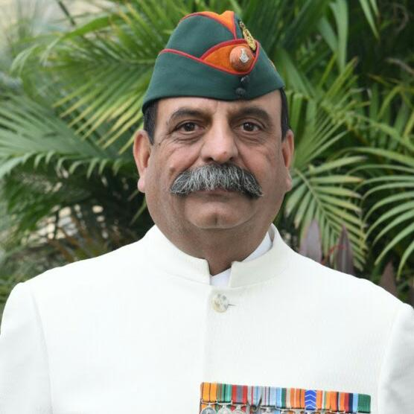
Maj Gen AK Siwach, YSM, VSM**
1. Maj Gen AK Siwach, YSM, VSM** commanded Infantry Brigade on Line of Control in High Altitude in North Kahmir.During his command of two years from 2007 to 09 the Brigade was successful in eleminating reord number of foreign terrorists trying to infiltrate in Kashmir Valley. For his dynamic leadership and bold offensive actions, he was awarded Yudh Seva Medal in 2011.
2. He headed Territorial Army over two years from 2012 to 14. During his tenure the TA achieved greater heights unparalleled in it's history. For his innovative and dynamic leadership he was awarded Bar to VSM in 2015.

Slide 22
Col Dharamveer Singh, SM
16 SIKH
School No. 2691
House: Chillianwala
Batch: 1985-92
On 19th Jul 2000 at 1000 hrs Lt (now Col) Dharamveer Singh as Ghatak Platoon Cdr, on receiving the specific info launched an operation. In fierce gun battle he along with his team neutralized two terrorists who were hiding in a house at village of Distt Rajouri (J&K). For displaying conspicuous bravery, courage in face of frenzied terrorist he was awarded “SENA MEDAL” (Gallantary).

